Slide 1
Accessing Cal Pass PLus
A tutorial

Slide 2
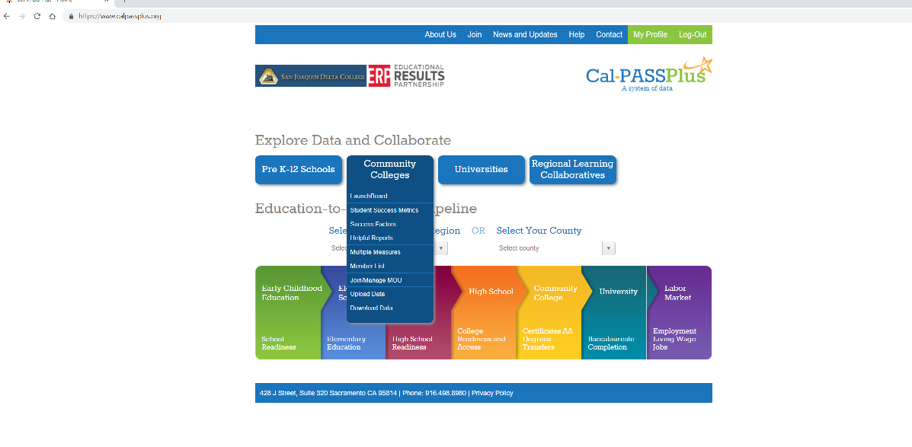
Step 1
Go to www.calpassplus.org
On the home screen, select “Community Colleges”
On the drop down menu, select “Helpful Reports”
Community Colleges
Helpful Reports

Slide 3
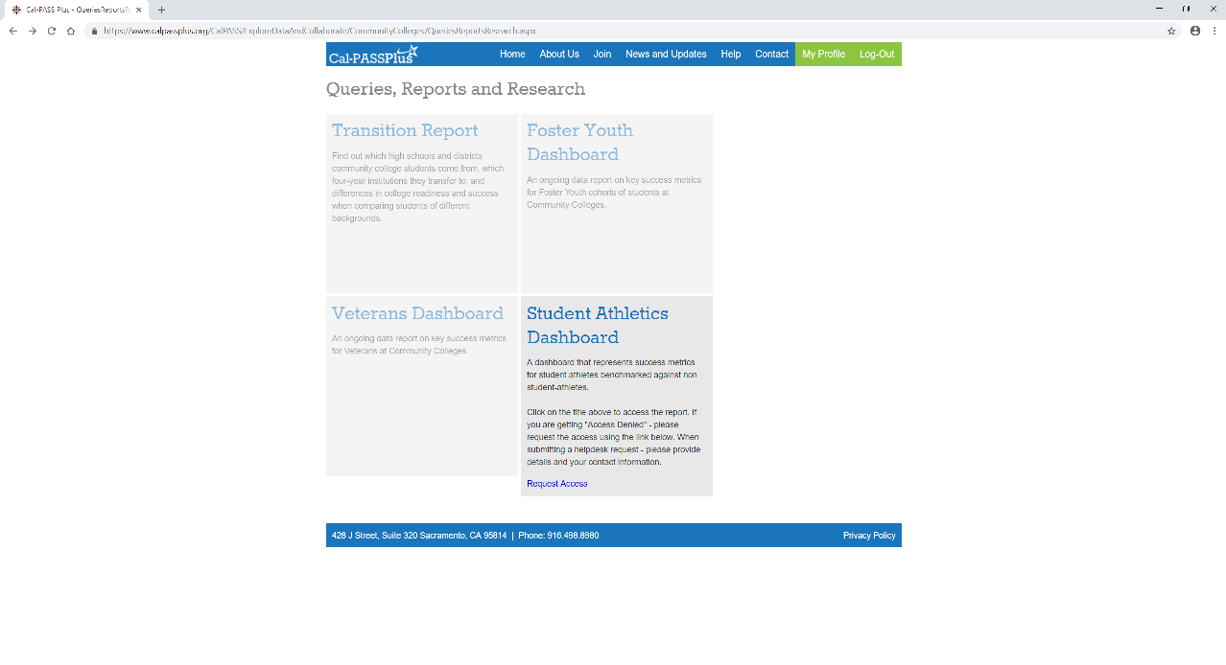
Step 2
Select “Student Athletics Dashboard”
If you have not previously requested access (a user name and log in), you will receive the prompt once you get to the next screen. The response from CalPass is relatively quick so if you haven’t received it within a few hours, check your spam folder.
Request Access prompt

Slide 4
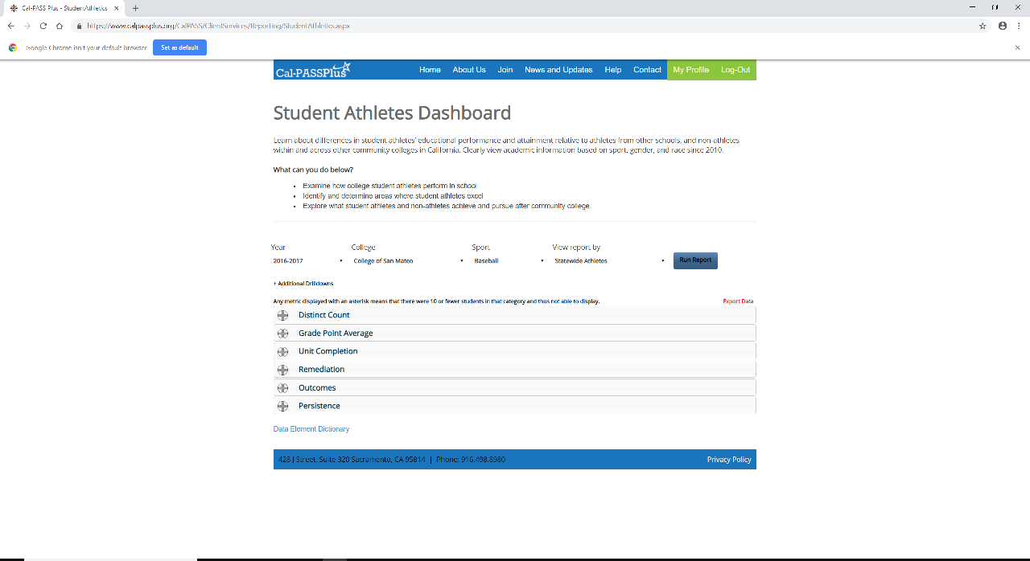
Step 3
You are now in! Let the data dredging begin.
There are many filters (drop down menus on the top) you can chose from – I have selected 2016/17, College of San Mateo, Baseball, and would like to compare it to all athletes statewide.
Select “Run Report”
Drop Down Menu’s
Run Report

Slide 5
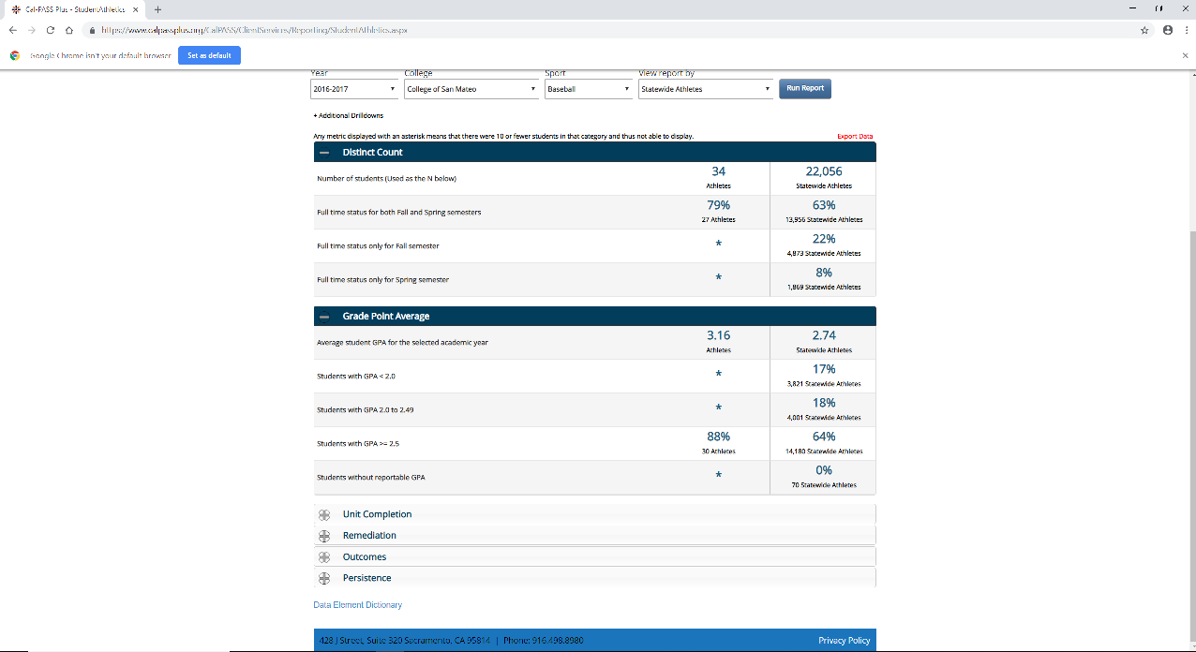
Step 4
Now that you have run this report, you can see how the Baseball players compare to the rest of the student-athletes statewide.
The drop down menu’s on the left side will provide you with the comparative metrics.
Results
Drop Down menu for comparative metrics
By clicking on the “+” the results will show

Slide 6
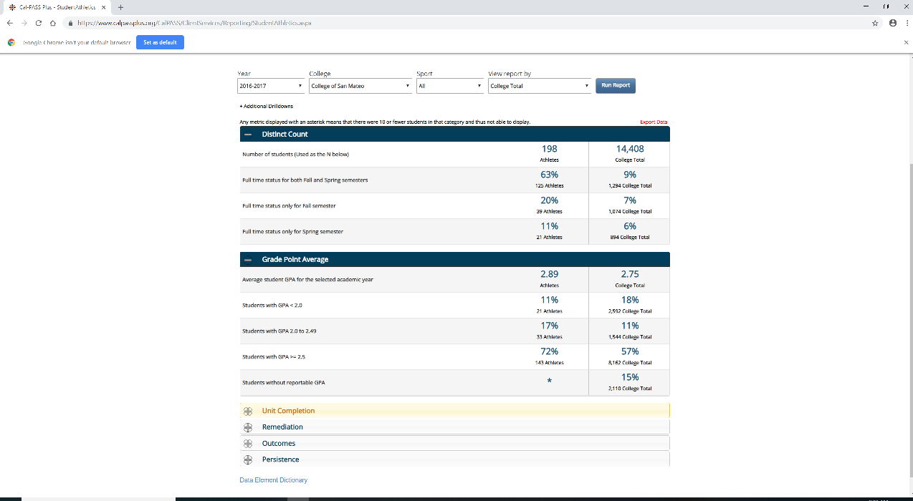
Additional Analysis
You can compare all of your student athletes with your college (non-student athlete) cohort. To create another analysis, simply go to the top menu bar and change the filters (always be sure to select “Run Report” after you have changed your filters).
Run Report
Filters Changed

Slide 7
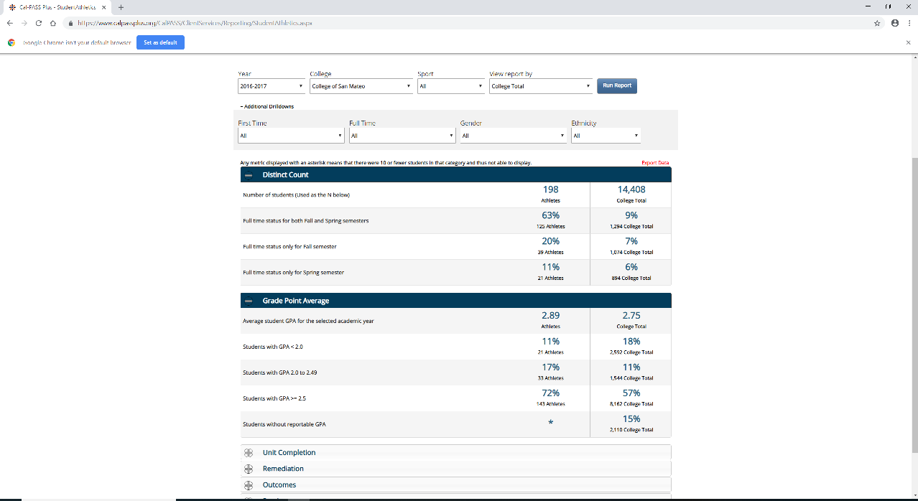
Additional drill-downs
(Somewhat Hidden)
The additional drill downs will provide you with other comparative metrics such as ethnicity, gender, etc.
Select “Additional Drill Downs”

Slide 8
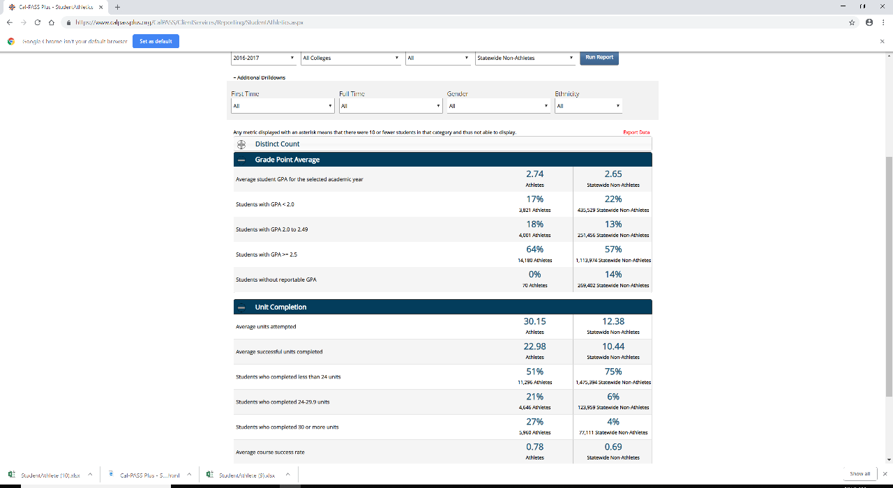
General overview
In this analysis, we can look at all state-wide athletes vs. all state-wide non-athletes to get a general overview of their academic performance.
Unit completion is a very important metric

Slide 9
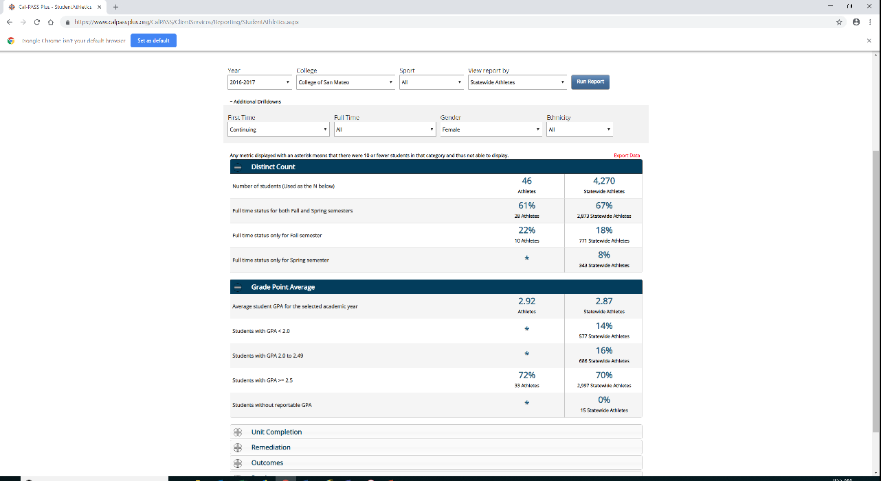
More analysis…
Every time you change a filter, you need to select “Run Report”
In this analysis, we are comparing for 2016/17, “continuing females, all ethnicities, all sports at College of San Mateo against all state-wide athletes.
You can go in and change any filter but always remember to ‘Run Report”. For example, if I want to look at Hispanic Females, I go to “Ethnicity,” select the metric, then click on “Run Report.

Slide 10
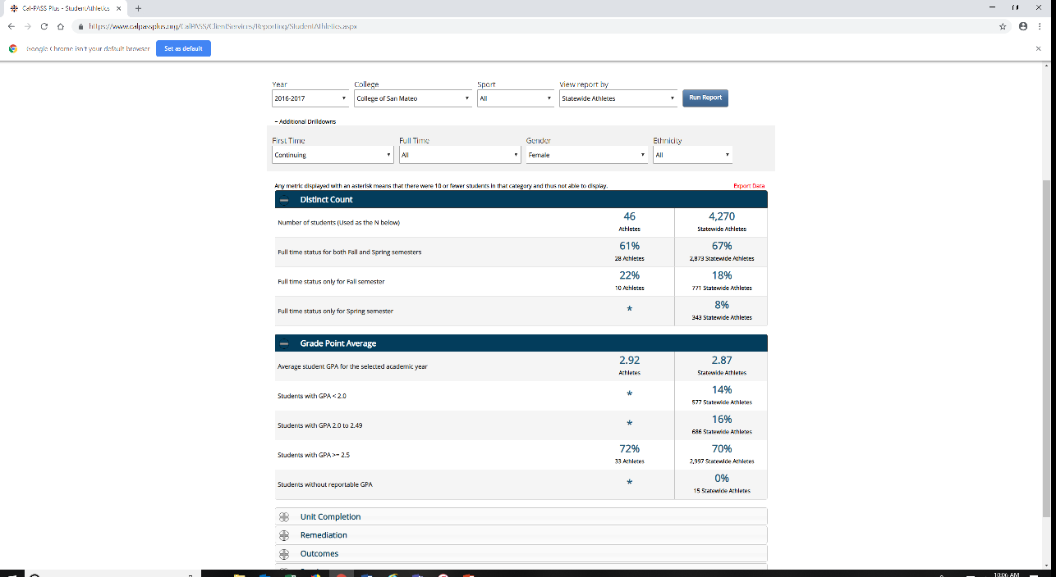
Getting Fancy…
You can “export” your data into an Excel Spreadhseet
.Click “Export Data”
You will receive a report you can print or At the top of the report, you can select “export to excel” and you will receive a report in an excel format.

Slide 11
End of presentation

